Slide 1

Predicting customer buying behaviour
20/11/2022

Slide 2
predictive model to understand factors that influence buying behaviour
We have trained the data set with Random forest classifier model & XGB Boost ML Models:
 | Random Forest | XGB Boost
Accuracy | 84.896 | 84.768
AUC Score | 0.5377 | 0.54436

Slide 3
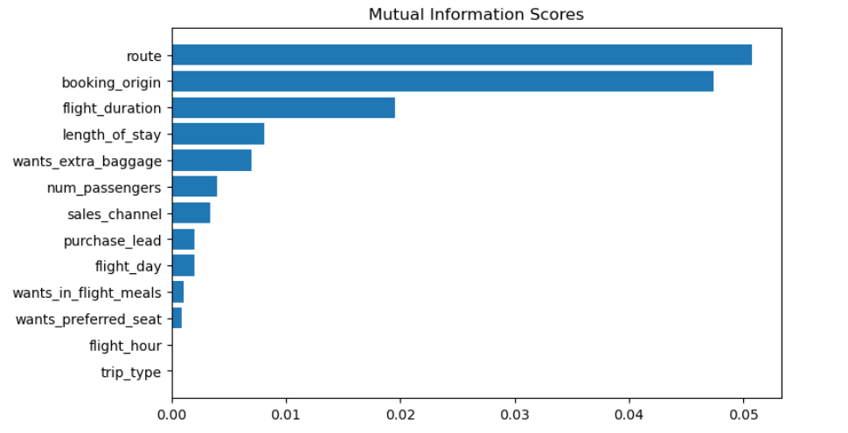
predictive model to understand factors that influence buying behaviour
Top buying influencing factors:
Route
Booking_origin
flight_duration
Length_of_stay
Wants_extra_baggage
Sales_Channel

